Slide 1

Legal Aspects of Business
Dr. J Bhavani, Faculty,
Business School
Vellore Institute of Technology

Slide 2
Recapitulate
The companies Act, 2013
Difference between Private Company and Public Company
Minimum No. of Members
Maximum No. of Members
Article of Association
Commencement of Business
Invitation to the Public
Transferability of Shares
Quorum
No. of Directors
Statutory Meeting and Report
Restriction on Appointment of Directors
Managerial Remuneration
Dr. J Bhavani, VIT

Slide 3

The Companies Act, 2013
Formation and Incorporation of Company
Stages Involved in Formation of Company
I. Promotion of a Company
Promotion is a process by which a company is incorporated or brought into being as a ‘Corporate Body’. In order words, Promotion is the discovery of business opportunities and the subsequent organisation of funds, property and managerial ability into a business concern for the purpose of making profits therefrom. The person who undertake all these activities known as promotors.
Dr. J Bhavani, VIT

Slide 4
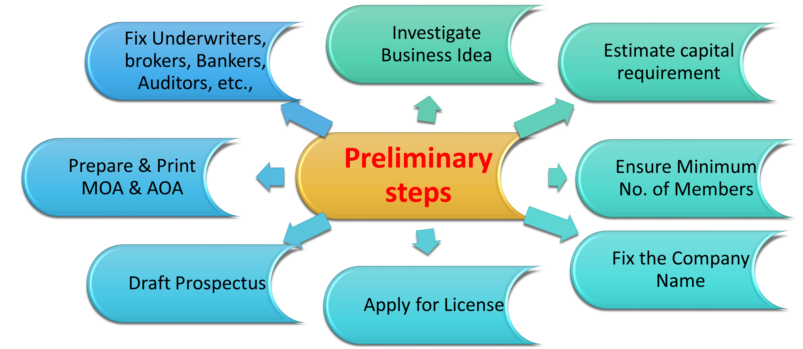
The Companies Act, 2013
Preliminary steps taken by the promoters
Dr. J Bhavani, VIT

Slide 5
The Companies Act, 2013
II. Incorporation or Registration of a Company
Filing documents with Registrar
The Memorandum of Association
The Articles of Association
A statement of the nominal or authorised capital
A list of directors and their consent to act as such, signed by each
An undertaking in writing signed by each director to take and pay for their qualifying shares
The Agreement, if any
A Declaration by advocate of the Supreme Court or High Court, an Attorney or Pleader or by a person named in the Articles as Director, Manager or Secretary of the company.
Dr. J Bhavani, VIT

Slide 6
The Companies Act, 2013
Registration of Documents
The registrar has to be satisfied on the following points;
The relevant documents has been properly made
The objects of the company are lawful
The requisite no. of persons required under the Act have subscribed and duly signed
The MOA or AOA comply in all respects with the provisions of the Act
The name selected by the company is acceptable
The statutory declaration has been properly made
Dr. J Bhavani, VIT

Slide 7
The Companies Act, 2013
Effects of Incorporation
Company obtains separate legal entity
Artificial legal person
Perpetual succession
Separate property
Dr. J Bhavani, VIT

Slide 8
The Companies Act, 2013
III. Capital Formation
This is applicable only for a public company having a share capital. Directors would file a copy of the prospectus with the Registrar and invite the public to subscribe to the shares of the company.
Dr. J Bhavani, VIT

Slide 9
The Companies Act, 2013
IV. Certificate of Incorporation
On registration, the Registrar will issue a certificate of incorporation whereby he certifies that the company is incorporated. Form the date of incorporation mentioned in the certificate, the company becomes a legal person separate from its shareholders and secures a perpetual succession. Hence it is the birth certificate of the company.
Dr. J Bhavani, VIT

Slide 10
The Companies Act, 2013
Certificate of commencement of business
A private company may commence its business immediately on incorporation but a public company cannot commences business immediately after incorporation, unless it has obtained a certificate of commencement of business from the Registrar.
Dr. J Bhavani, VIT

Slide 11

Review Questions
A certificate of incorporation is a conclusive evidence that all the requirements of the Companies Act have been complied with. True or False
The certificate of incorporation alone is sufficient to commence business of a public company. True or False
A person who undertakes to form a company with reference to a given project is known as promoter. True or False
Dr. J Bhavani, VIT

Slide 12

Answer
A certificate of incorporation is a conclusive evidence that all the requirements of the Companies Act have been complied with.
Answer: False
2. The certificate of incorporation alone is sufficient to commence business of a public company.
Answer: False
3. A person who undertakes to form a company with reference to a given project is known as promoter.
Answer: True
Dr. J Bhavani, VIT

